Slide 1
Energy Minimization of Green Fluorescent Protein
Jack Ustanik

Slide 2
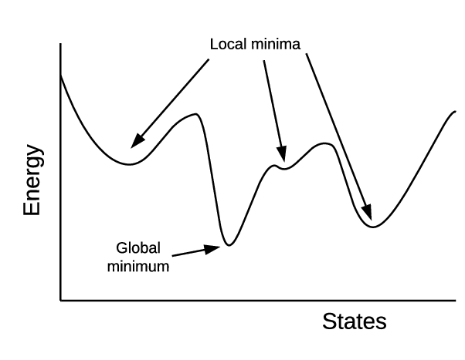
Energy Minimization
Purpose of energy minimization is to find the exact coordinates which will provide the smallest value for the Total Potential Energy Function
Lowest amount of energy is energetically favorable
Different structure conformations can produce various local minima and a global minimum
In nature and lab setting finding the minimized structure is ideal

Slide 3
Force Fields
Force Fields, also known as the Total Potential Energy, are composed of various molecular interactions which include: Bond Energy, Angle Energy, Torsion, Van der Waals interactions, Electrostatic interactions
Structures have their own unique values for each of the force field potential functions
Finding the lowest Total Potential Energy when minimizing a structure

Slide 4
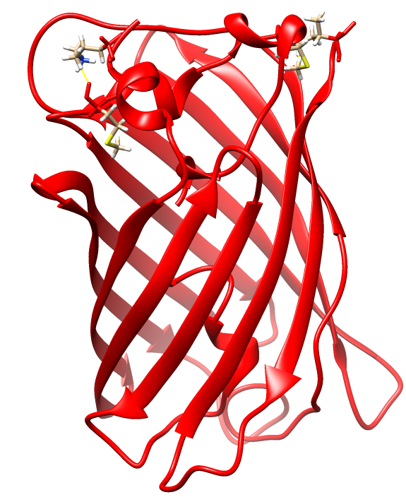
How?
Computational methods allow for simulations regarding energy minimization to be made
Through various minimization algorithms, the most optimal coordinates of a structure can be calculated
With high performance computing the potential energies of the protein structure 1EMA, Green Fluorescent Protein from Aequorea Victoria can be minimized
GFP useful for visualization

Slide 5
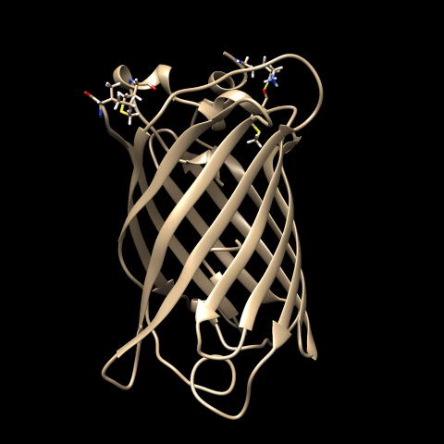
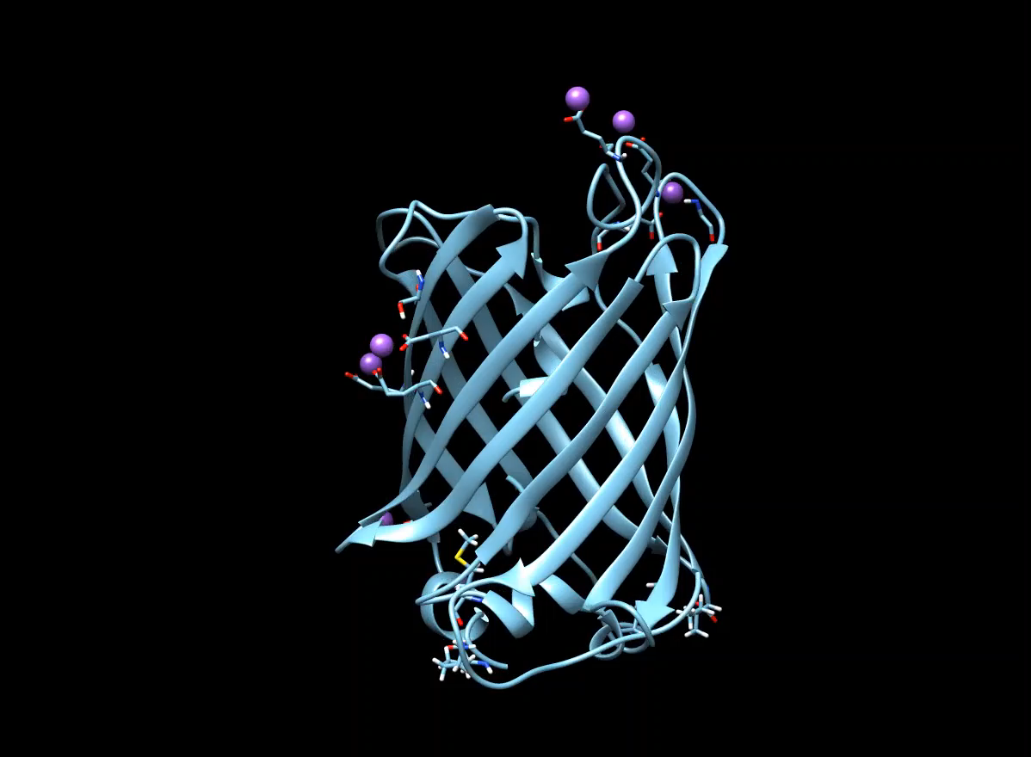
Overall Protein Structure
Original Minimized

Slide 6
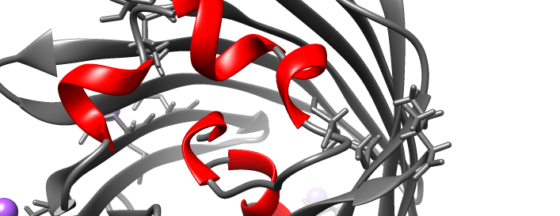
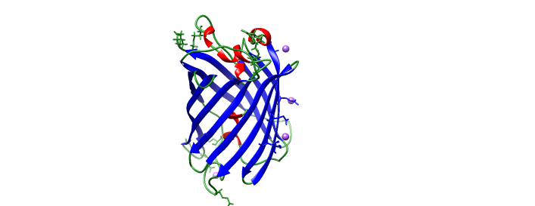
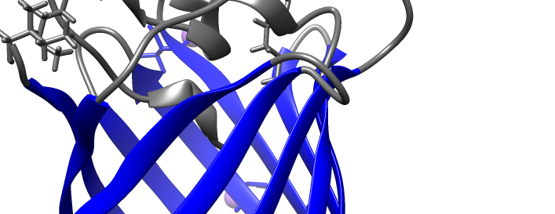
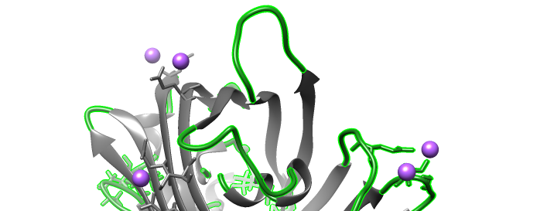
Overall Protein Structure
GFP Protein is composed of:
11 Beta Strands that make up a beta-barrel (Blue)
5 Alpha Helices (Red)
Random Coils (Green)
Alpha Helix
Beta Sheets
Random Coil

Slide 7
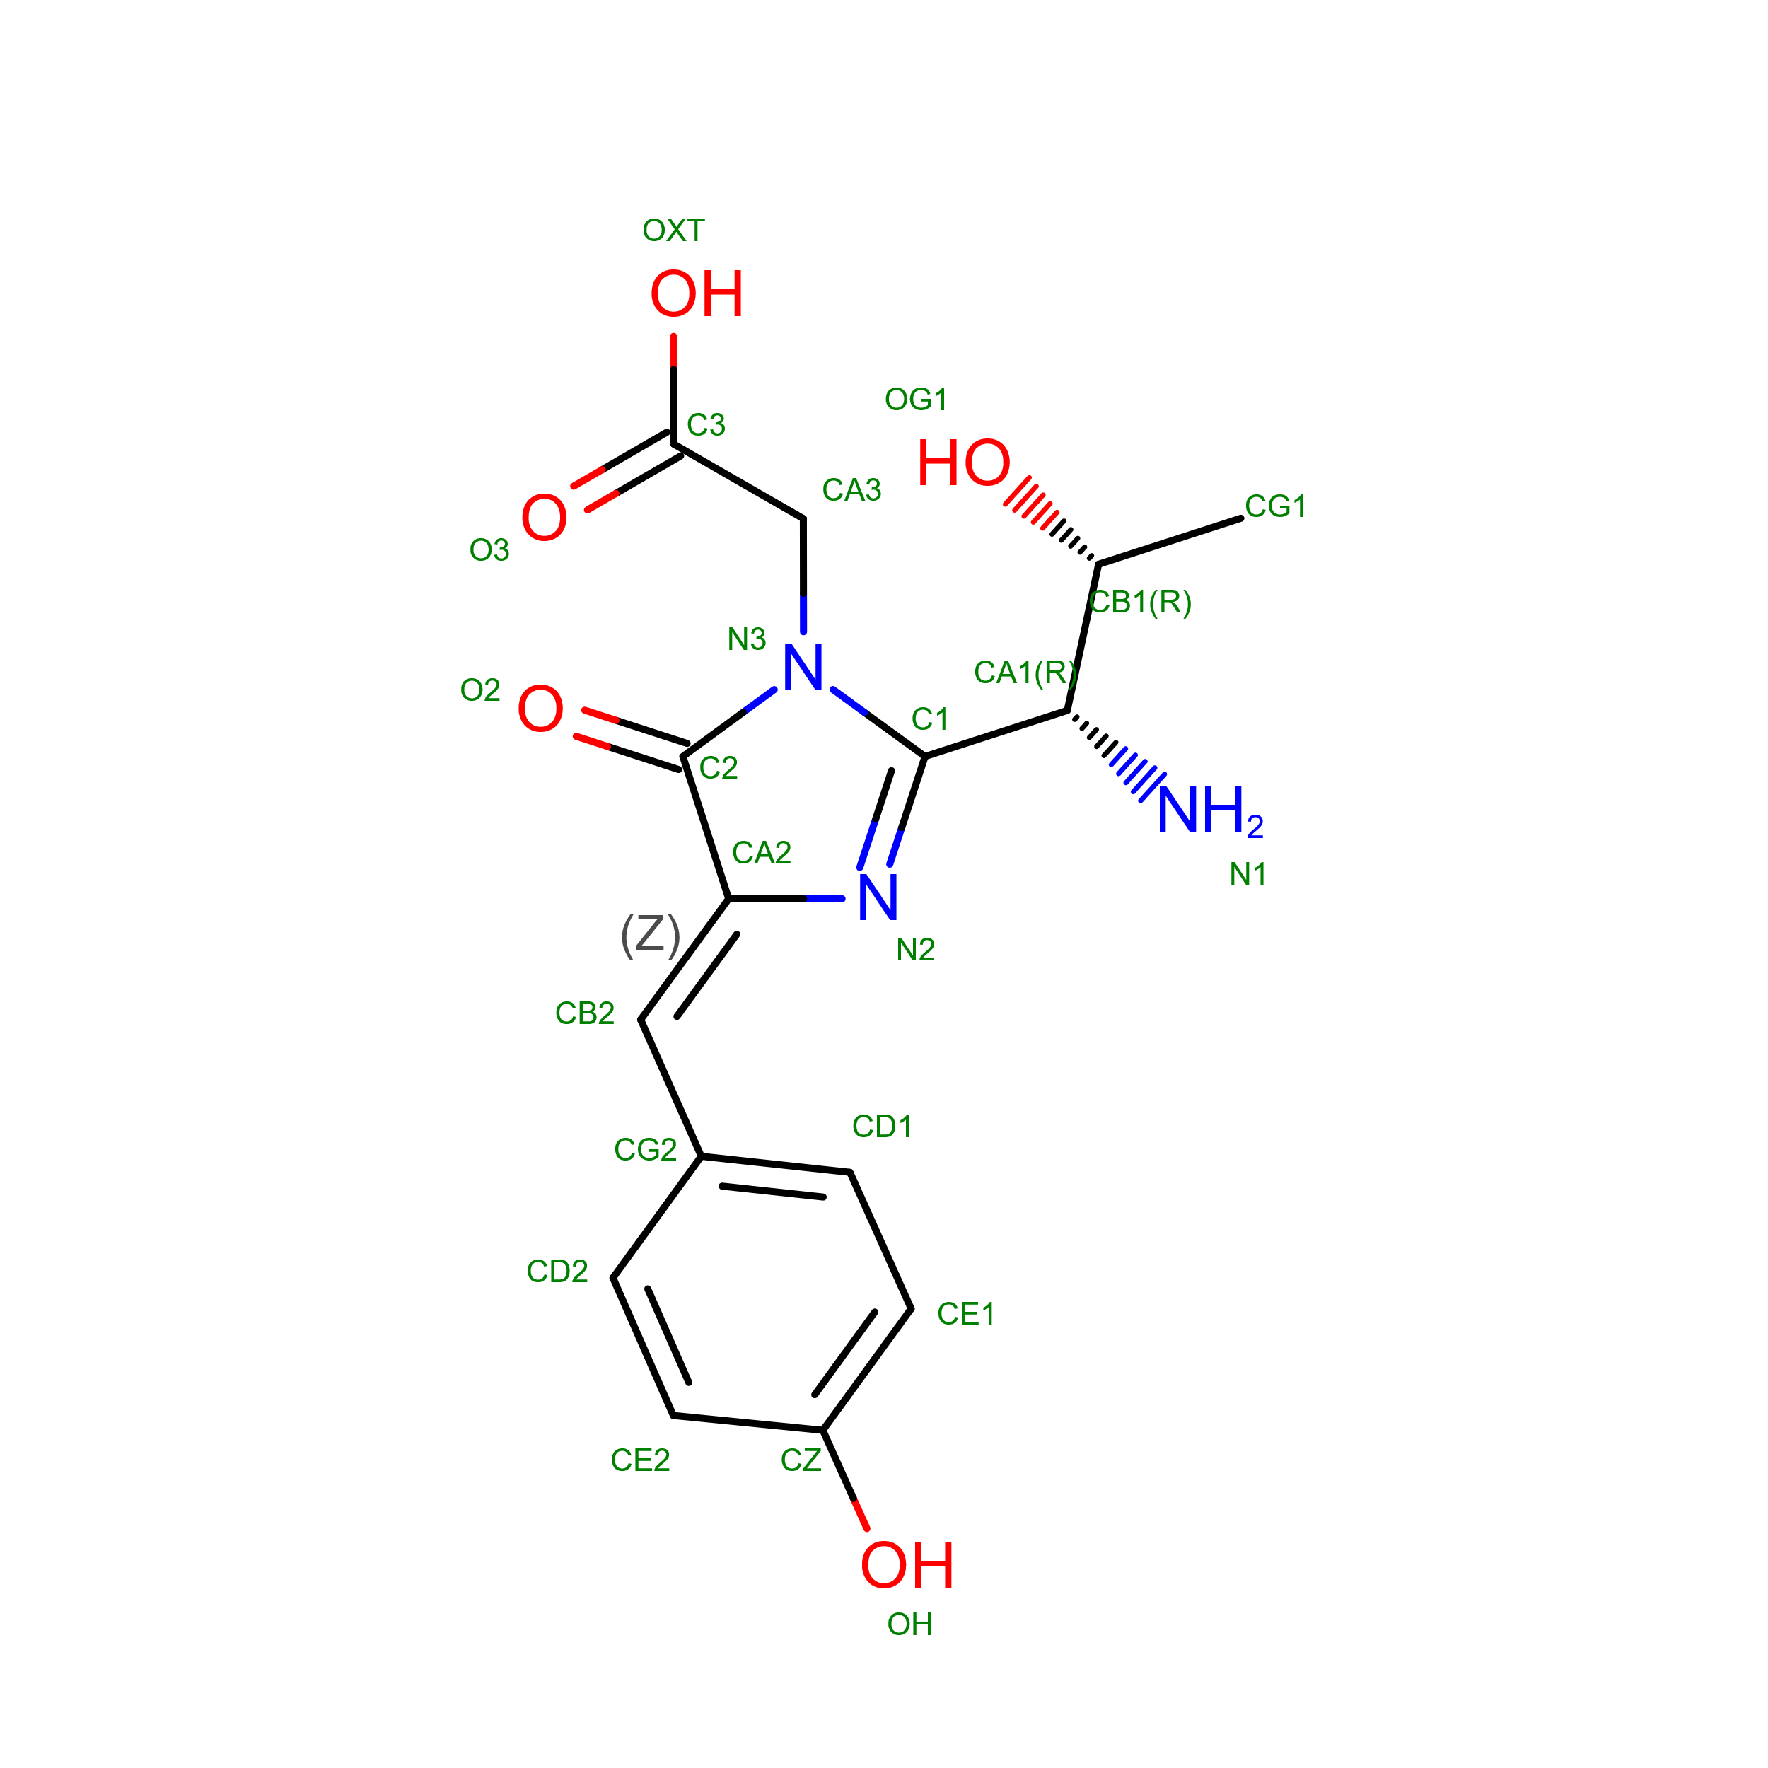
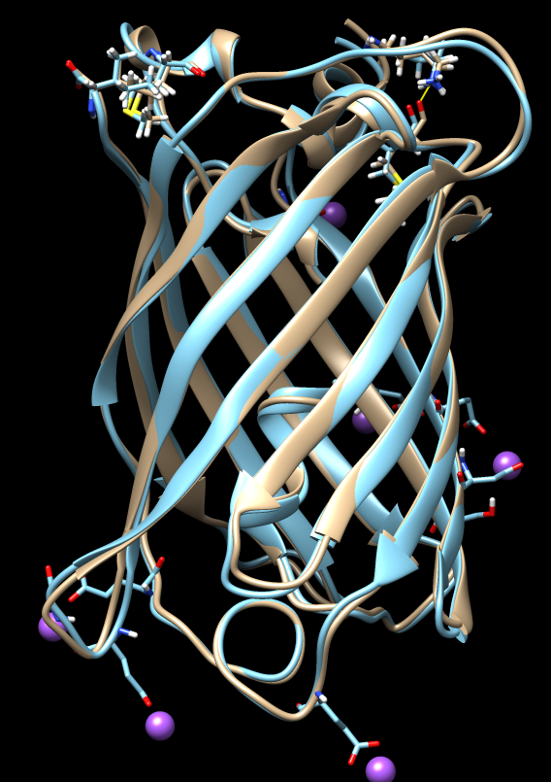
CRO Residue
Within the central helix of the protein
An oxidation and cyclization reaction promote fluorophore formation
When activated the CRO residue will emit a green fluorescence
Alpha helix within the barrel structure contain the CRO residue
Made up of three amino acid residues
THR⁶⁵ TYR⁶⁶ GLY⁶⁷
Temperature, Oxygen Concentration, pH impact folding

Slide 8
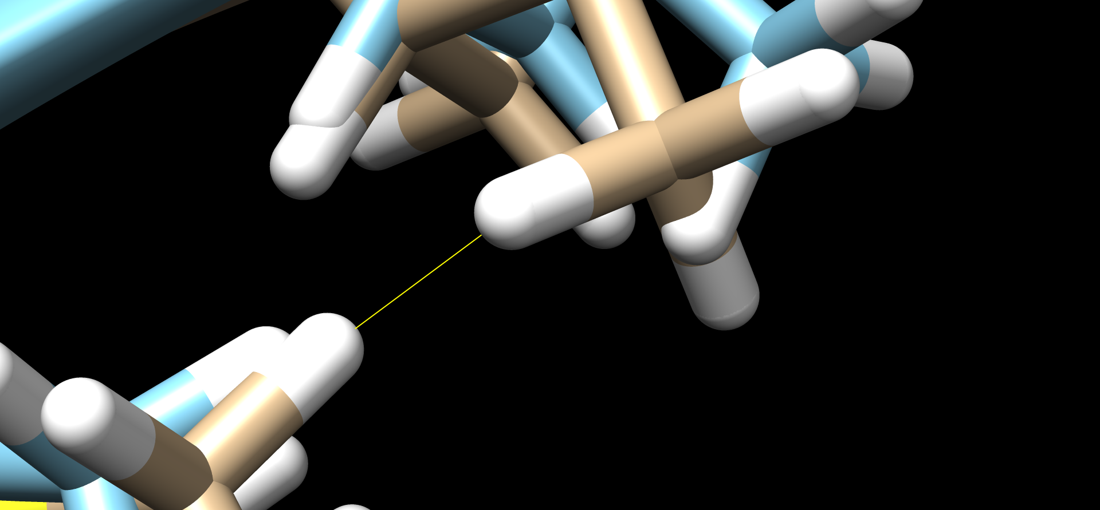
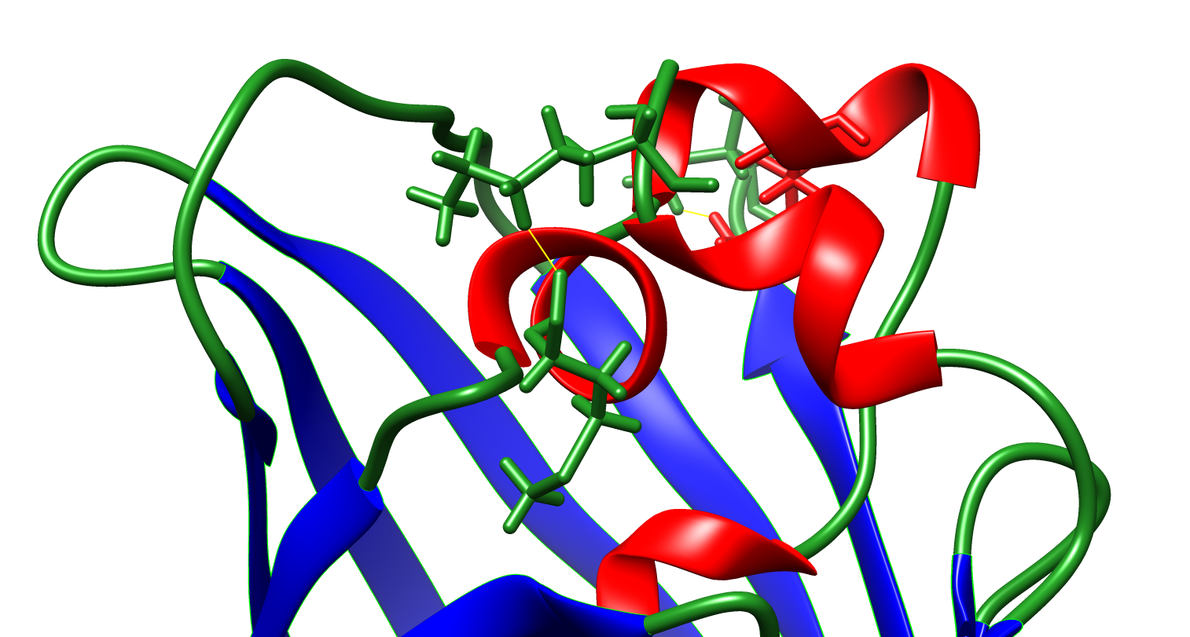
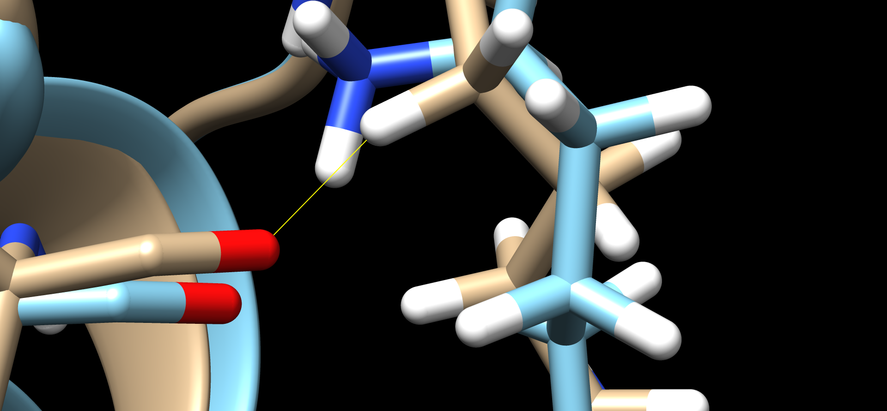
Clashes
#1 MET 75 HE3
#1 ILE 226 HD12
#0 MET 75.A HE3 #0 ILE 226.A HD12 0.703 1.297
Through computations which minimized the original structure 2 clashes were eliminated
Slight changes occurred in the orientation of the atoms
#1 LYS 2 HD2
#1 MET 85 O
#0 MET 85.A O #0 LYS 2.A HD2 0.735 1.745

Slide 9
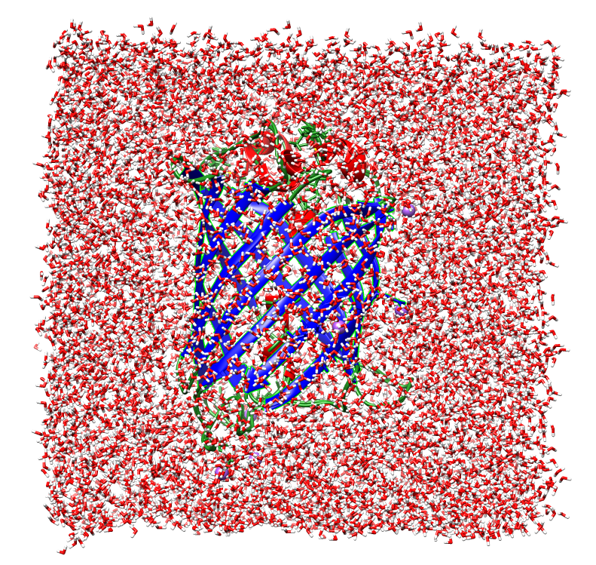
Solvent Box
Solvation of GFP protein
Stability increase of structure
Using tleap missing atoms are added

Slide 10
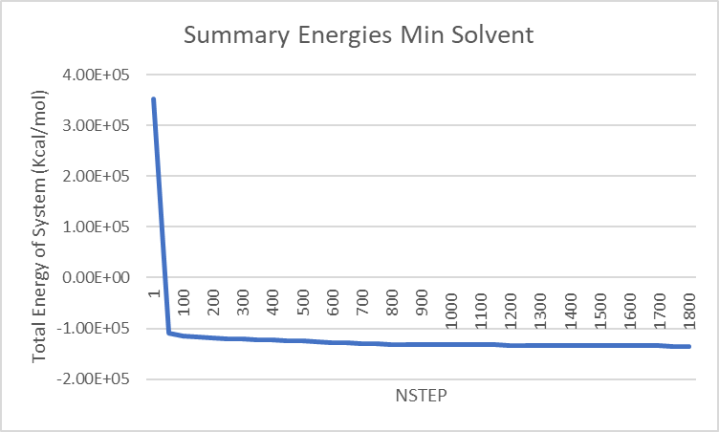
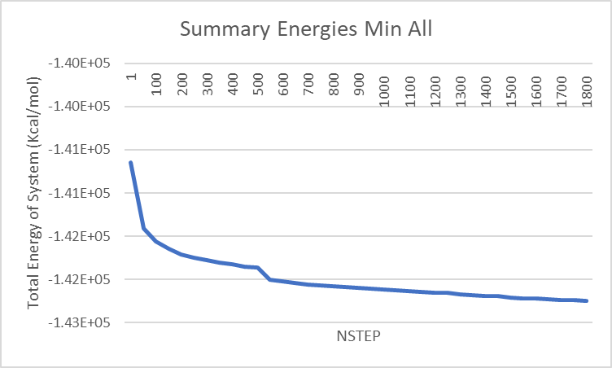
Energy of System
Trends:
Reduction in Energy of the System
Steep drop in Energies with leveling out

Slide 11
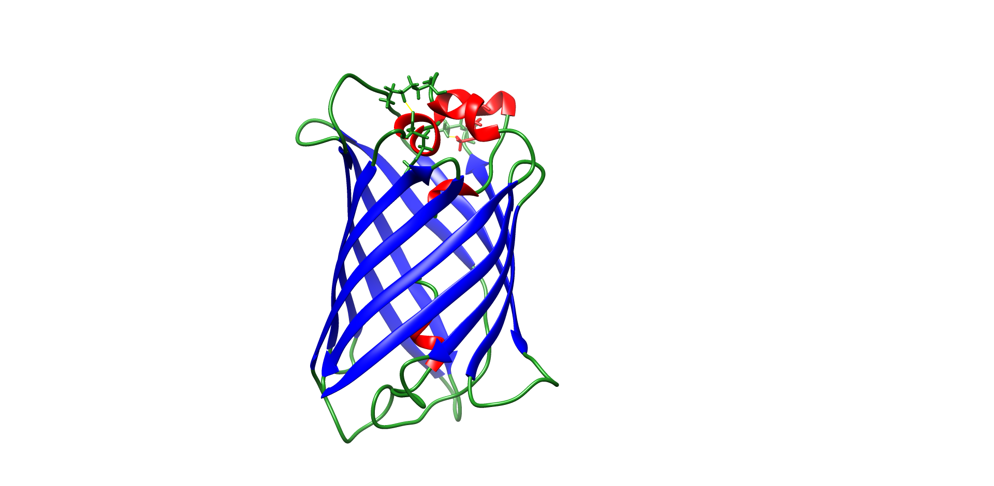
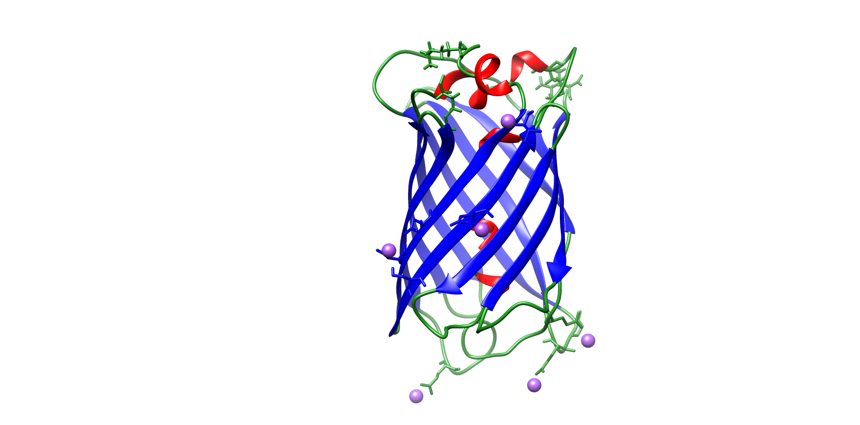
Structures
Original Minimized

Slide 12
Take Away
Computational methods can produce alternative structures for the same protein
With AMBER energy minimization of the Green Fluorescent Protein (GFP) can produce a more energetically favorable structure
Rearrange to avoid clashing (structure #1)
CRO residue is responsible for fluorescence in GFP
Process results in reduction of energies of the system
Advantages vs Disadvantages

